Slide 1
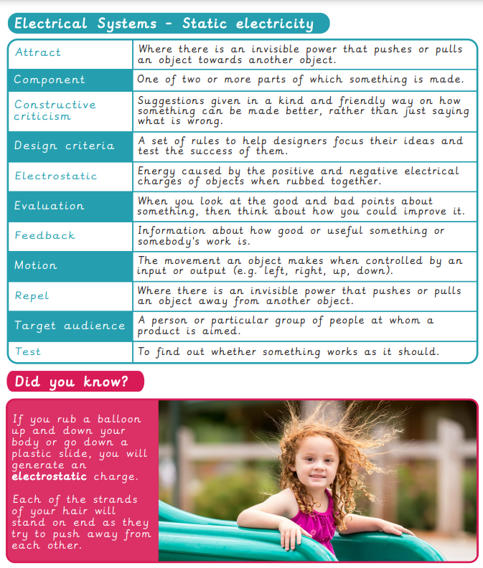
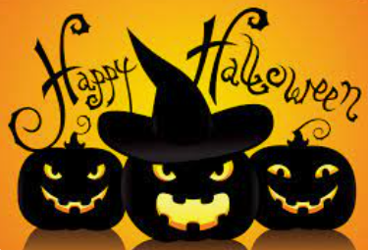
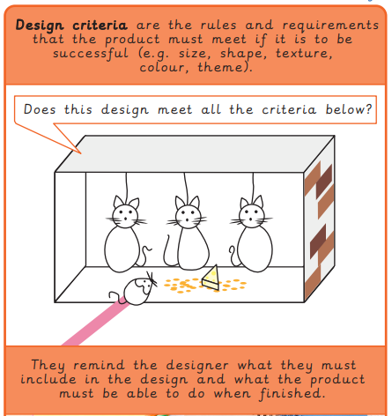
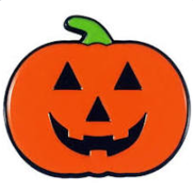
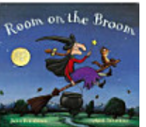
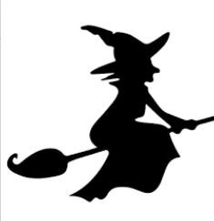
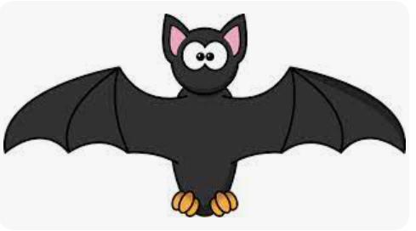
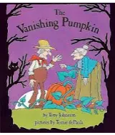
Vocabulary
Subject: Design & Technology
Concept: Electrical Systems-Halloween Static Electricity Game
Online activities:
Static electricity fun experiment!
5 Fun experiments you can do at home
READ ME FOR HALLOWEEN INSPIRATION!
Room on the Broom
The Vanishing Pumpkin

