Slide 1
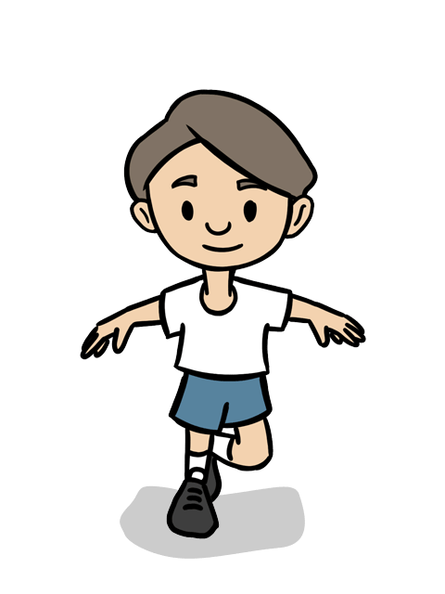
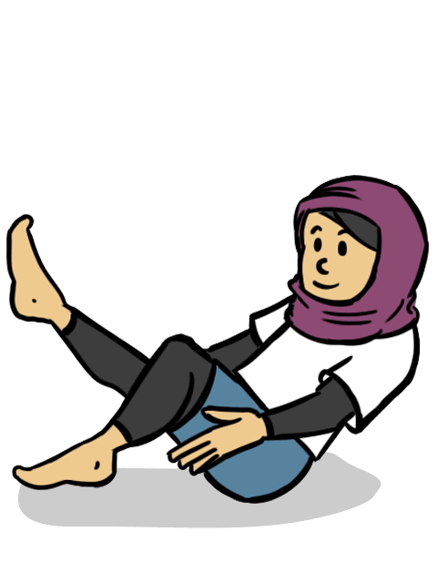
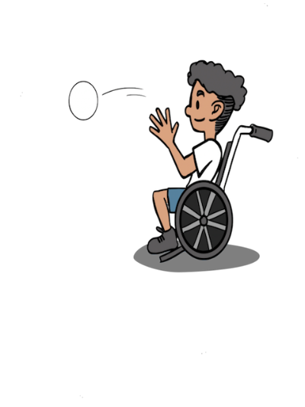
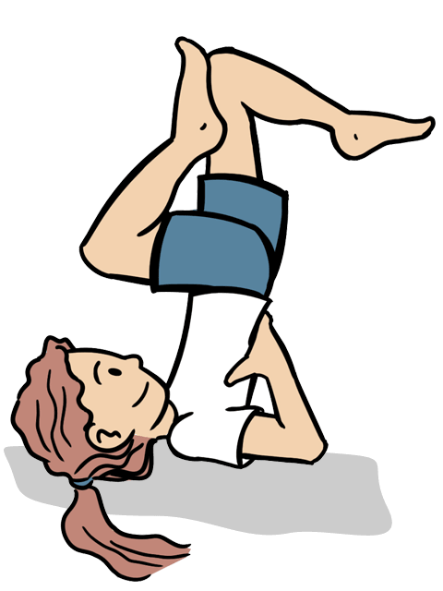
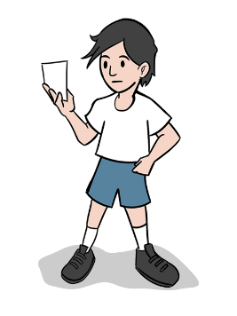
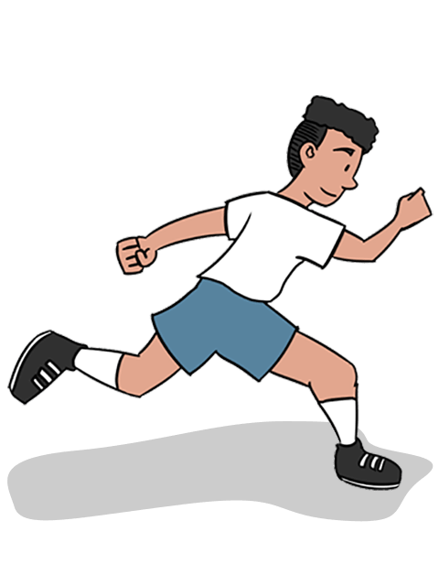
Physical Education
Year 1 and 2 Cycle A
How to support your child’s learning at home:
Hold a family sports day (Click here for some ideas)
Join a local Junior Park Run (Click here for more information)
Ask your child to show off the skills they have learnt in their PE lesson
Fundamentals
Key Skills: Balancing, sprinting, jogging, dodging, jumping, hopping, skipping, taking turns, supporting and encouraging others ,working safely, communication, challenging myself, perseverance, honesty, selecting and applying, identifying strengths, listening and following instructions
Dance
Key Skills: travel, copying and performing actions, using shape, balance, coordination, co-operation, communication ,coming to decisions with a partner, respect, confidence ,acceptance, counting, observing and providing feedback, selecting and applying actions
Gymnastics
Key Skills: travelling actions, shapes, balances, jumps, barrel roll, straight roll, forward roll progressions, sharing, working safely, confidence, observing and providing feedback, selecting and applying actions
Target Games
Key Skills: underarm throwing, overarm throwing ,aim, hand eye co-ordination, communication, supporting and encouraging others, leadership, perseverance, honest, fair play, using tactics, selecting and applying skills, decision making
Team Building
Key Skills: balancing, travelling actions, communication, sharing ideas, inclusion, encouraging and supporting others, confidence, trust, honesty, decision making ,using tactics,: providing instructions, planning, problem solving
Athletics
Key Skills :Running at varying speeds ,agility, balance, jumping, hopping and leaping in combination and for distance ,throwing for distance, working safely, collaborating with others, working independently, honesty and playing to the rules, determination, exploring ideas
Your child could be the next……..
Ade Adepitan
Max Whitlock

Slide 2
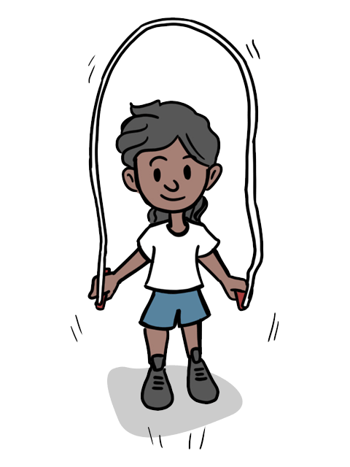
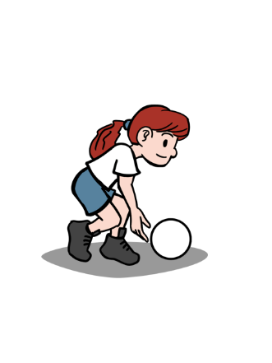
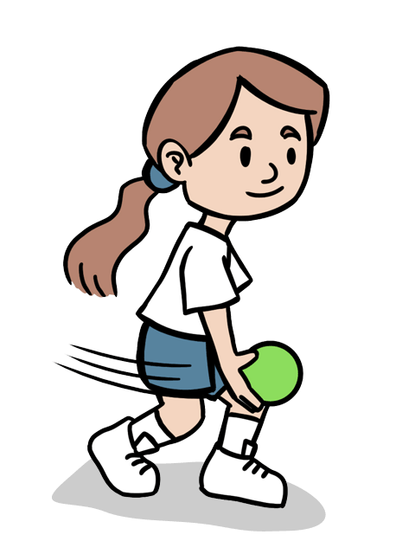
Physical Education
Year 1 and 2 Cycle B
How to support your child’s learning at home:
Swimming is the perfect healthy activity for families to do together at the weekend. Many local pools offer fun inflatable sessions and other water- based activities Click here for a list of local indoor swimming pools
Fundamentals
Key Skills: rolling, kicking, throwing, catching , bouncing, dribbling, co-operation, communication, leadership, supporting others, honesty, perseverance, challenging myself, using tactics, exploring actions
Dance
Key Skills: shapes,balances,shape jumps, travelling movements, barrel roll,straight roll,forwards roll, sharing, working safely,confidence,independence, observing and providing feedback, selecting and applying
Gymnastics
Key Skills: shapes, balances, shape jumps, travelling movements, barrel roll,straight roll, forwards roll,sharing,working safely,confidence, independence,observing and providing feedback,selecting and applying
Fitness
Key Skills: agility ,balance, co-ordination, speed, stamina, skipping, taking turns, encouraging and supporting others, determination, perseverance, challenging myself, identifying strengths and areas for improvement, observing and providing feedback
Your child could be the next……..
Carlos Acosta
Joe Wicks
Georgia Jones
Click on the links to find out more!
Sending and Receiving
Key Skills: rolling, kicking, throwing, catching, tracking, co-operation, communication, keeping others safe, perseverance, challenging myself, identifying how to improve, transferring skills
Striking and Fielding
Key Skills: throwing and catching, tracking a ball, bowling, batting, communication, collaboration, honesty, acceptance, controlling emotions, select and apply, using tactics, decision making

