Slide 1
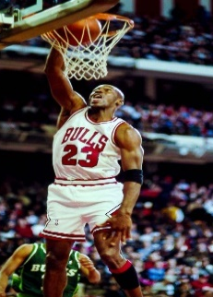
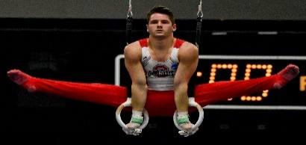
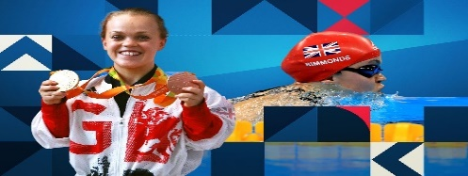
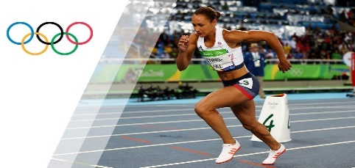
Topic: Ball Skills
Concept: Games
Skills Needed:
Physical: Throwing, catching, dribbling.
Social: Co-operation and communication.
Emotional: Perseverance, honesty, respect.
Recommendations: If you enjoyed practising ball skills then you may want to try out: Football, basketball, cricket or even hockey!
Here is the link to the famous
basketballer Michael B Jordan’s biography.
https://www.britannica.com/biography/Michael-Jordan
Topic: Gymnastics
Concept: Body Management
Skills Needed:
Physical: Various jumping styles, balances and rolls.
Social: Collaboration, communication and respect.
Emotional: Confidence.
Thinking: Evaluating and improving and providing feedback.
Recommendations: Practise some of the skills you have learnt during PE and show your grown up at home!
Following this link will take you to a fantastic floor routine completed by Katelyn Ohashi.
https://www.youtubekids.com/watch?v=Ra_HScKBU_U
Topic: Football
Concept: Games
Skills Needed:
Physical: Dribbling, passing, ball control and receiving.
Social: Communication, collaboration and cooperation.
Thinking: Decision making and applying tactics.
Recommendations: Enjoy football? Practise at home with a ball or try out for your local football team!
Here is a short clip of Harry Kane (pictured
above) at the 2018 World Cup!
https://www.youtubekids.com/watch?v=8qCfG5_jqiY
Subject: Y3/4 Physical Education (PE) Cycle A
Topic: Swimming
Concept: Fundamentals
Skills Needed:
Physical: Submersion, various strokes, floating, treading water, H.E.L.P and huddle position and rotation.
Social: Supporting and encouraging others.
Thinking; Comprehension and planning tactics.
Recommendations: Why not try swimming outside of school and go for some family fun!
Watch the video to see Ellie Simmonds win the Paralympic gold and break a world record in the 2012 Paralympic games!
https://www.youtubekids.com/watch?v=sqip074zDzE
Topic: Athletics
Concept: Fundamentals
Skills Needed:
Physical: Sprinting, jumping and throwing for distance.
Social: Working collaboratively and working safely.
Emotional: Perseverance and determination.
Recommendations: Practise your sprinting technique and race your peers at break and lunch times!
Follow the link to find out facts all about gold Olympic medalist Jessica Ennis-Hill!
https://kids.kiddle.co/Jessica_Ennis-Hill
Topic: Rounders
Concept: Games
Skills Needed:
Physical: Underarm and overarm throwing, batting, fielding, catching and tracking a ball.
Social: Communication, encouraging others and respect.
Emotional: Honesty and fair play and managing emotions.
Thinking: Decision making and using tactics.
Recommendations: Practise your throwing and catching skills to get even better!
Find out the rules for rounders to be super prepared!
https://www.roundersengland.co.uk/play/rounders-rules/

Slide 2
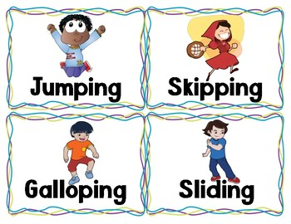
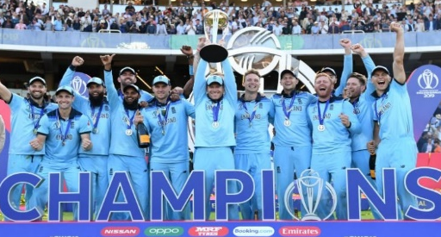
Topic: Fundamentals
Concept: Fundamentals
Skills Needed:
Physical: Running, hopping, jumping and skipping.
Social: Taking turns, supporting and encouraging others.
Emotional: Challenging myself and perseverance.
Recommendations: Set up a mini obstacle course including all of your fundamental skills!
Topic: Netball
Concept: Games
Skills Needed:
Physical: Passing, catching, footwork, shooting and intercepting.
Social: Working safely and communication.
Emotional: Perseverance, honesty and fair play.
Recommendations: If you enjoy netball why not try a similar sport such as basketball?
Check out the England netball team also known as the “Vitality Roses Squad”
https://www.englandnetball.co.uk/england/vitality-roses/squad/
Topic: Gymnastics
Concept: Body Management
Skills Needed:
Physical: Various jumping styles, balances and rolls.
Social: Collaboration, communication and respect.
Emotional: Confidence.
Thinking: Evaluating and improving and providing feedback.
Recommendations: Practise some of the skills you have learnt during PE and show your grown up at home!
Following this link will take you to a fantastic floor routine completed by Katelyn Ohashi.
https://www.youtubekids.com/watch?v=Ra_HScKBU_U
Subject: Y3/4 Physical Education (PE) Cycle B
Topic: Swimming
Concept: Games
Skills Needed:
Physical: Submersion, various strokes, floating, treading water, H.E.L.P and huddle position and rotation.
Social: Supporting and encouraging others.
Thinking; Comprehension and planning tactics.
Recommendations: Why not try swimming outside of school and go for some family fun!
Watch the video to see Ellie Simmonds win the Paralympic gold and break a world record in the 2012 Paralympic games!
https://www.youtubekids.com/watch?v=sqip074zDzE
Topic: Athletics
Concept: Games
Skills Needed:
Physical: Sprinting, jumping and throwing for distance.
Social: Working collaboratively and working safely.
Emotional: Perseverance and determination.
Recommendations: Practise your sprinting technique and race your peers at break and lunch times!
Follow the link to find out facts all about gold Olympic medalist Jessica Ennis-Hill!
https://kids.kiddle.co/Jessica_Ennis-Hill
Topic: Cricket
Concept: Games
Skills Needed:
Physical: Underarm and overarm throwing, catching, under and overarm bowling, fielding and batting.
Social: Respect and communication.
Emotional: Perseverance and honesty.
Recommendations: Find your local cricket club!
https://www.ecb.co.uk/play/find-a-club/

