Slide 1
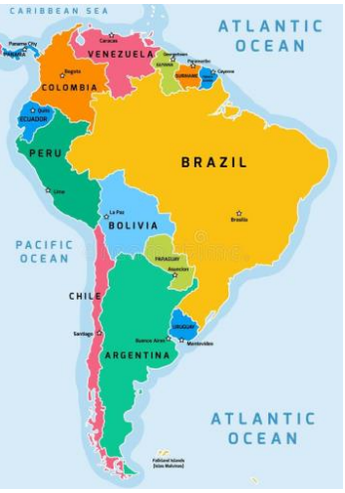
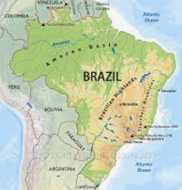
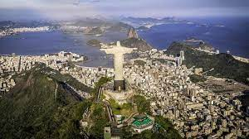
Concept: Place knowledge; locational knowledge; human and physical geography; geographical skills - Y5/6
Topic: South America - Brazil
Previously, I have learnt …
In Y5/6, I am learning…
In the future, I will learn …
My Future
To name and locate the seven continents and five oceans of the world
To locate countries in South American using maps, atlases and digital technology
To locate the major rainforests of the world
Scientist
Teacher
Environmentalist
Town planner
Researcher
Geographer
To identify and locate some major physical features of South America
To understand and describe key physical features of a rainforest
To name and locate The Mediterranean Sea and some of the countries that boarder it including Greece
To locate the capital cities of South America
To explain the effects that humans are having on the rainforest
To name and locate the capital cities of at least four European countries
What Brazil is like as a country including its population and economy
To describe the climate of a rainforest biome and link this to its location on the map.
Why the climate of Greece (and other Mediterranean countries) is different to England
To identify the human and physical features of Brazil
To locate Brazilian cities using 4 and 6 figure grid references
About some indigenous people who live in the Amazon Rainforest
To identify and name landmarks and features of Greece
The main differences between Sheffield and Greece (climate, coast, tourism, food)
To identify and describe Brazil’s 6 ecosystems
The climate varies across different environmental regions within Brazil
The similarities and differences between Sheffield and Brazil
How physical and human characteristics can affect the lives and activities of people living in Brazil
To give an extended description of human characteristics of Brazil.
Continent
ocean
South America
Border
Country
capital city
man-made
Physical feature
natural
lake
mountains
River
Desert
Biome
Amazon River
Brazil
Brasilia
Rio de Janeiro
slum
rural
Urban
ecosystem
tropical rainforest
Caatinga (desert),
Pantanal (wetlands)
Cerrado (savannah)
Pampas
Atlantic forest
Rochinha favela
Barra da Tijuca
inequality
Poverty
Amazon basin
Amazon Rainforest
biodiversity
emergent layer canopy
understory
forest floor
deforestation climate change endangered
extinct
indigenous people

Slide 2
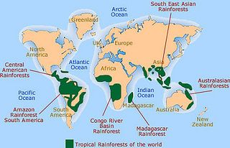
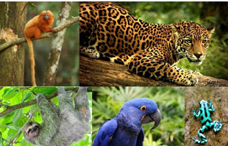
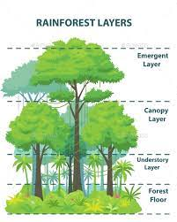
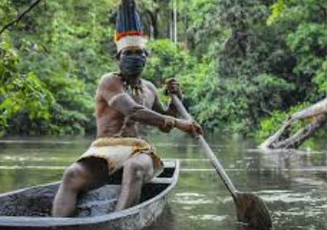
Concept: Locational knowledge; human and physical geography - Y5/6
Topic: Rainforests
Previously, I have learnt …
In Y3/4, I am learning…
In the future, I will learn …
My Future
To name and locate the seven continents of the world
To locate the major rainforests of the world
How human and physical processes interact to influence, and change landscapes, environments and the climate; and how human activity relies on effective functioning of natural systems
Geographer
Water management
Park ranger
Teacher
Researcher
Environmentalist
To locate countries in South American using maps, atlases and digital technology
identify the position and significance of longitude (Equator, Tropic of Cancer and Tropic of Capricorn)
To identify and locate some major physical features of South America
To describe the climate of a rainforest biome and link this to its location on the map.
The ecosystems and climate varies across different environmental regions within Brazil
To understand and describe key physical features of a rainforest
What Brazil is like as a country including its population and economy
What natural resources are found in the rainforests
Some of the species of animals in the rainforests that are endangered
How physical and human characteristics can affect the lives and activities of people living in Brazil
The effects that humans are having on the rainforest
Which fruits and vegetables are produced in the Mediterranean and why they are exported to different countries
About some indigenous people who live in the Amazon Rainforest
Continents
Climate
Ecosystem
biome
Equator
Amazon Rainforest Amazon river
Ecosystem
tropical rainforest Amazon Rainforest
Biome
biodiversity
emergent layer canopy
deforestation climate change endangered
extinct
indigenous people

Slide 3
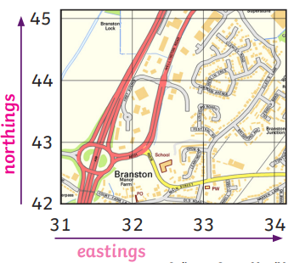
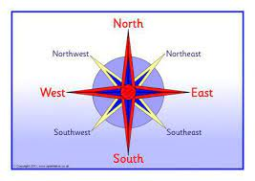
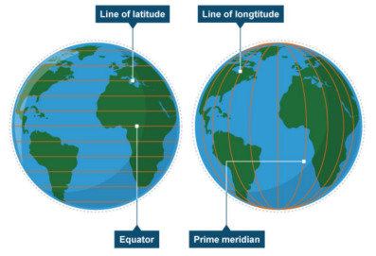
Concept: Locational knowledge; human and physical geography; geographical skills - Y5/6
Topic: I’m a Rainbow Pupil, get me out of here! - Maps
Previously, I have learnt …
In Y5/6, I am learning…
In the future, I will learn …
My Future
Which is N, E, S and W on a compass and to use compass directions to describe the location of a feature.
I can identify the position and significance of latitude and longitude.
To build on my knowledge of globes, maps and atlases and apply and develop this
knowledge routinely in the classroom and in the field.
Teacher
Geographer
Cartographer
Local researcher
Architect
Park ranger
Landscaper
Town planner
I can identify the position and significance of the Prime/Greenwich Meridian.
To read a simple street map.
I understand and can explain the position and significance of time zones (including day and night).
The symbols used in maps to identify physical and manmade features.
To use Geographical Information Systems (GIS) to view, analyse and interpret places and data.
I can recognise all key symbols used on ordnance survey maps.
To describe the physical features of the Peak District National Park.
To use fieldwork in contrasting locations to collect, analyse and draw conclusions from
geographical data, using multiple sources of increasingly complex information.
I can use OS maps to answer questions.
To use aerial photographs to recognise features.
I can use the 8 points of the compass.
To make my own simple map and use simple symbols in a key.
I can use 4 and 6 grid references.
I can use maps, aerial photos, plans and web resources to describe what a locality might be like.
The position and significance of the Equator, Northern Hemisphere, Southern Hemisphere, the Tropics of Cancer and Capricorn, Arctic and Antarctic Circle.
I can use digital technologies to measure distances and record human and physical features in the local area.
Continents
Northern Hemisphere
Southern Hemisphere Tropic of cancer
Tropic of Capricorn
Bearing
Contour
Grid square
Landform
Ordnance Survey
relief
I can create a scale plan of the local area.
Latitude
Longitude
Greenwich / Prime Meridian
Meridian
Eastern Hemisphere
Western Hemisphere
Time zone
Symbol
Scale
digital map
Easting
Northing

