Slide 1
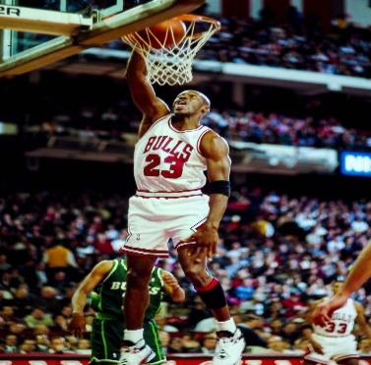
Topic: Basketball
Concept: Games
Skills Needed:
Physical: Dribbling, intercepting,
shooting, throwing and catching.
Thinking: Planning strategies and using
tactics, observing and providing feedback.
Emotional: Perseverance and fair play.
Recommendations: If you enjoy basketball, why not try the basketball after school club?
Watch the famous Michael B Jordan in action!
https://www.youtubekids.com/watch?v=cuLprHh_BRg
Topic: Football
Concept: Games
Skills Needed:
Physical: Ball control, goal keeping,
tracking and turning.
Social: Communication, cooperation and
respect.
Emotional: Honesty and perseverance.
Recommendations: https://find.englandfootball.com/ Use this link to find your local football team if you enjoy football!
Watch Ellie Roebuck do some fantastic goal keeper training! https://www.youtubekids.com/watch?v=Nssex828MT4
Topic: Gymnastics
Concept: Body Management
Skills Needed:
Physical: Various rolls, balances, cartwheels and counter balances and tension.
Social: Responsibility, collaboration and communication.
Thinking: Selecting and applying, observing and providing feedback.
Recommendations: If you enjoy gymnastics, why not try out doing some yoga at home? Not only is this practicing mindfulness but you can make your balancing even better!
Subject: Y5/6 Physical Education (PE) Cycle A
Topic: Fitness
Concept: Fundamentals
Skills Needed:
Physical: Strength, speed, power and agility.
Social: Working collaboratively and encouraging others.
Emotional: Perseverance and analysing scores.
Recommendations: There are so many different ways you can practice your fitness skills! Why not try a bleep test at home? Follow the link to see how to complete a successful bleep test.
https://www.youtubekids.com/watch?v=SkdS0tS02h0
Topic: Athletics
Concept: Fundamentals
Skills Needed:
Physical: Pacing, relay changeovers and techniques.
Social: Negotiating and supporting others.
Emotional: Perseverance and determination.
Recommendations: Why not practice relay racing on the yard with your friends at lunch and break times!
Watch Usain Bolt achieve a world record!
https://www.youtubekids.com/watch?v=93dC0o2aHto
Topic: Rounders
Concept: Games
Skills Needed:
Physical: Throwing, catching, bowling and batting.
Social: Organising and self-managing a game.
Emotional: Honesty & fair play, confidence and managing emotion.
Recommendations:
Find out the rules for rounders to be super prepared!
https://www.roundersengland.co.uk/play/rounders-rules/

Slide 2
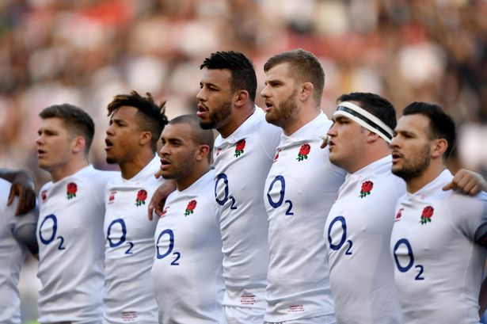
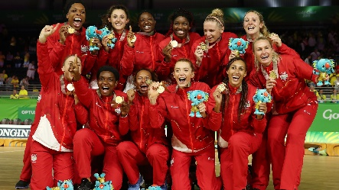
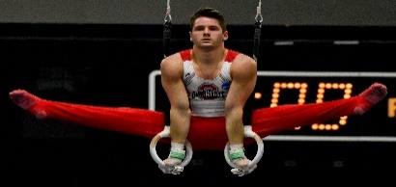
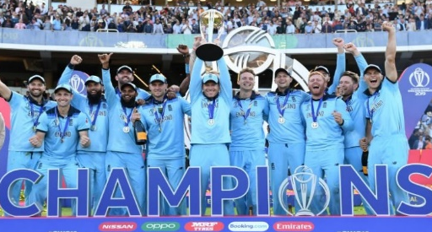
Topic: Tag Rugby
Concept: Games
Skills Needed:
Physical: Throwing, catching, dodging and scoring.
Social: collaboration and communication.
Emotional: Perseverance, honesty and respect.
Recommendations: If you enjoyed working in a team doing this team based sport then you may enjoy: football, hockey, basketball or netball!
Check out England’s rugby team!
https://www.youtubekids.com/watch?v=bTHFHtQIaQw
Topic: Netball
Concept: Games
Skills Needed:
Physical: Footwork, intercepting, dodging and shooting.
Social: Collaboration and communication.
Emotional: Perseverance, honesty and fair play.
Recommendations: If you enjoy doing netball, why not try out for the Y5/6 netball team?
Have a look at the netball rules to have an even better understanding!
https://kids.kiddle.co/Netball
Topic: Gymnastics
Concept: Body Management
Skills Needed:
Physical: Various rolls, balances, cartwheels and counter balances and tension.
Social: Responsibility, collaboration and communication.
Thinking: Selecting and applying, observing and providing feedback.
Recommendations: If you enjoy gymnastics, why not try out doing some yoga at home? Not only is this practicing mindfulness but you can make your balancing even better!
Subject: Y5/6 Physical Education (PE) Cycle B
Topic: Fitness
Concept: Fundamentals
Skills Needed:
Physical: Strength, speed, power and agility.
Social: Working collaboratively and encouraging others.
Emotional: Perseverance and analysing scores.
Recommendations: There are so many different ways you can practice your fitness skills! Why not try a bleep test at home? Follow the link to see how to complete a successful bleep test.
https://www.youtubekids.com/watch?v=SkdS0tS02h0
Topic: Athletics
Concept: Fundamentals
Skills Needed:
Physical: Pacing, relay changeovers and techniques.
Social: Negotiating and supporting others.
Emotional: Perseverance and determination.
Recommendations: Why not practice relay racing on the yard with your friends at lunch and break times!
Watch Usain Bolt achieve a world record!
https://www.youtubekids.com/watch?v=93dC0o2aHto
Topic: Cricket
Concept: Fundamentals
Skills Needed:
Physical: Long and short barrier, batting and catching.
Social: Collaboration and communication.
Thinking: Observing and providing feedback, selecting and applying tactics.
Recommendations: Find your local cricket club!
https://www.ecb.co.uk/play/find-a-club/

