Slide 1
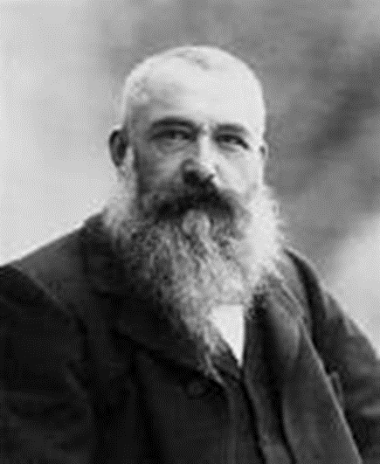
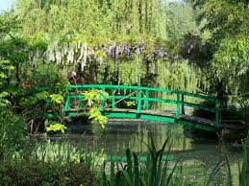
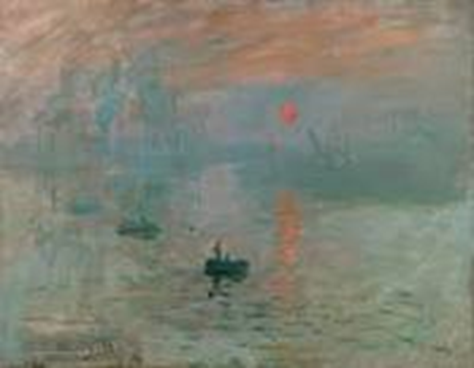
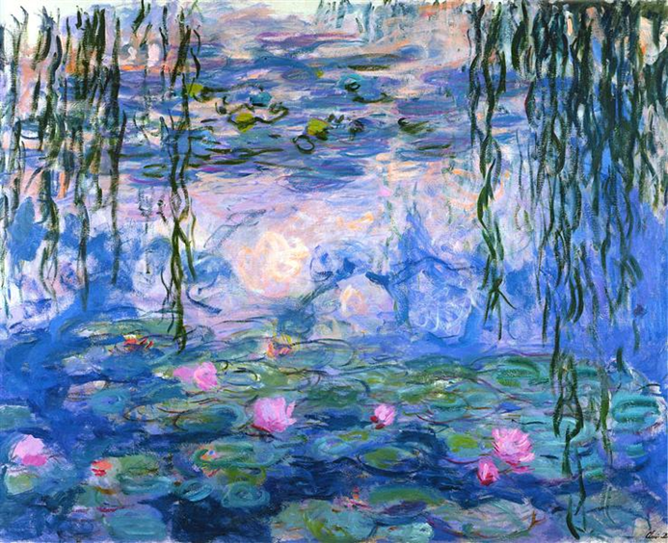
CLAUDE MONET - Impressionist Artist Painting unit: KS1 Knowledge Mat
Art Vocabulary
Landscape | A scene from outdoors that includes fields, buildings, the sky, trees.
Oil Paint | Pigment with linseed oil.
Brushstroke | Artists used sweeping brushstrokes to show movement in their paintings.
Impression | An artists interpretation of a scene or object.
Impressionists | A group of painters that liked to paint outside. They were bored with the dark, gloomy paintings and decided to introduce bright colours. They paint an ‘impression’ of what they see.
Reflection | Impressionists add light to paintings with white paint e.g to show reflection on the water.
Abstract | Use of marks, colours, shapes rather than realistic images.
Wax Resist | A sketch using wax with a watercolour wash.
Pastels | Powdery stick of colour, easily blended with fingers or cotton wool to give a subtle effect.
Collage | 3D layered effect with fabric, card ,papers, magazines and glue.
Sticky knowledge Claude Monet 1840-1926.French. Painted many masterpieces in his very own garden. French Impressionists painters liked to paint in the open air (outside) ‘en plein air’ as it is always changing! They used sweeping brushstrokes to capture movement and energy. Liked to paint with bright colours. As the light changes, tones are added to create shadows and highlights included to portray the light as the sun shines for example. Impressionists could paint the same thing at different times of day and the painting would be different each time.
Monet’s garden Giverny, France.
Claude Monet
Other impressionist Painters:
Berthe Morisot
Edgar Degas
Pierre-Auguste Renoir
Camille Pissaro
‘Impression,Sunrise’ 1872
‘Waterlilies’ 1916-1919

Slide 2
‘Waterlilies’ by Claude Monet

Slide 3
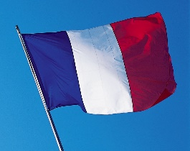
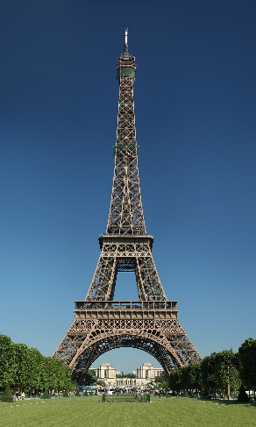
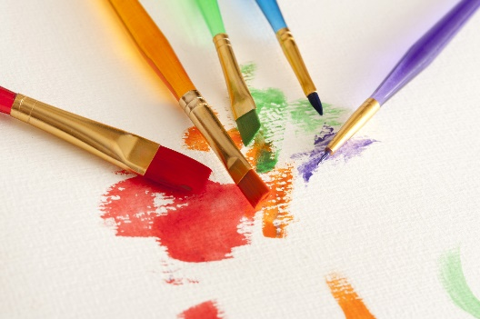
Art Vocabulary
Landscape | A scene from outdoors that includes fields, buildings, the sky, trees.
Oil Paint | Pigment with linseed oil.
Brushstroke | Artists used sweeping brushstrokes to show movement in their paintings.
Impression | An artists interpretation of a scene or object.
Impressionists | A group of painters that liked to paint outside. They were bored with the dark, gloomy paintings and decided to introduce bright colours. They paint an ‘impression’ of what they see.
Reflection | Impressionists add light to paintings with white paint e.g to show reflection on the water.
Sticky Knowledge
Claude Monet
Born-1840
Died- 1926.
French
Painted many masterpieces in his very own garden.
French Impressionists painters liked to paint outside.
They used sweeping brushstrokes to capture movement and energy.
Liked to paint with bright colours.
Other impressionist Painters:
Berthe Morisot
Edgar Degas
Pierre-Auguste Renoir
Camille Pissaro

Slide 4
Quiz
•Who were the impressionists?
•Where did they enjoy painting?
•What did they like to paint?
•What colours did they enjoy working with?
•What were the brushstrokes they used?
•Can you name a famous impressionist painter?
•Can you remember a painting he created?

Slide 5
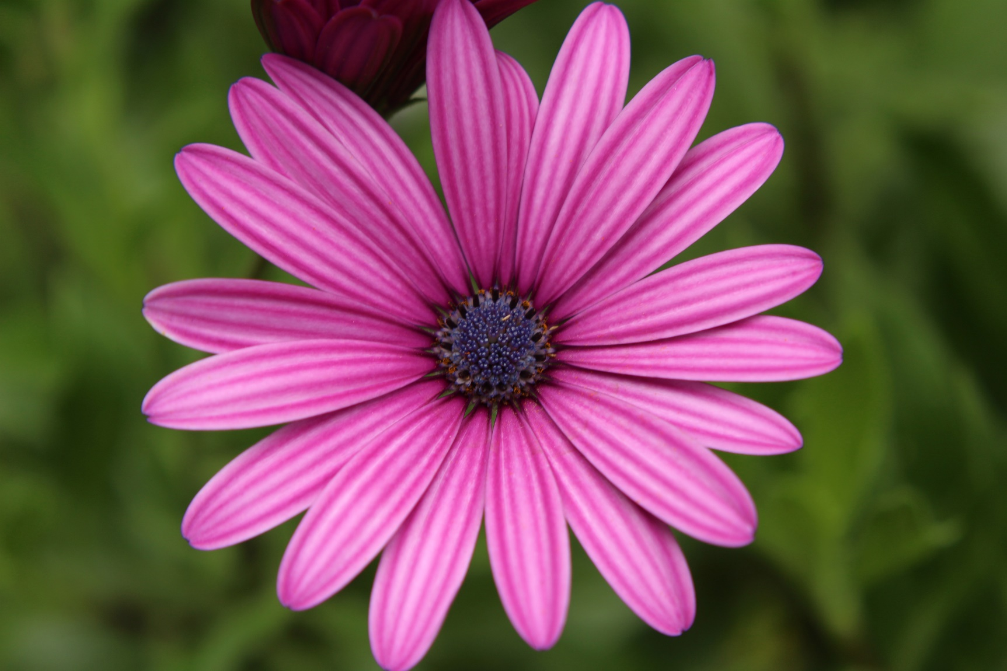
Skill: Mark making and tonal shading.
Skill: Sketch close-up of still life using line, mark making and tonal shading.
Model: Look closely at fresh flowers through magnifying glasses.
What shapes can we see within the flower e.g petals, leaves? Stamen?
Intricate details.
What colours can we see?
If I only have a pencil how will I show the different colours?
Dark to light shading (pencils asleep).
Depict detail through marks- dots, dashes, squiggles.
Using a 2H use the shapes children have spotted to draw an outline of a flower, looking closely at the petal shape, centre, stalk, leaves etc-observational drawing.

Slide 6
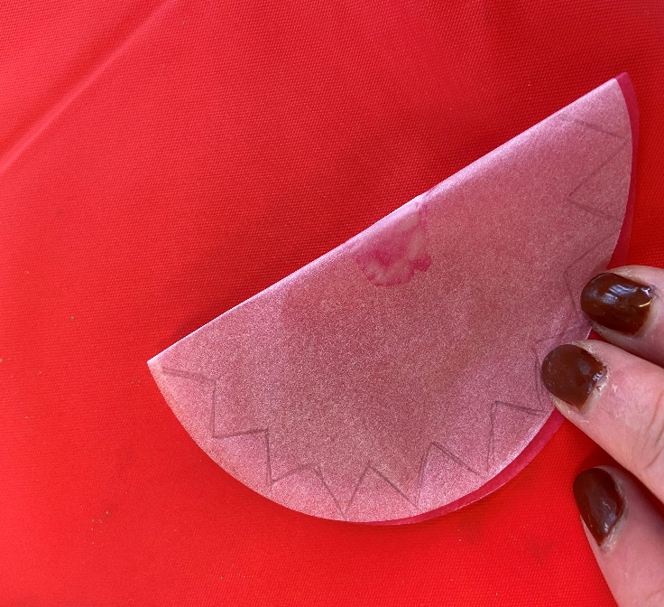
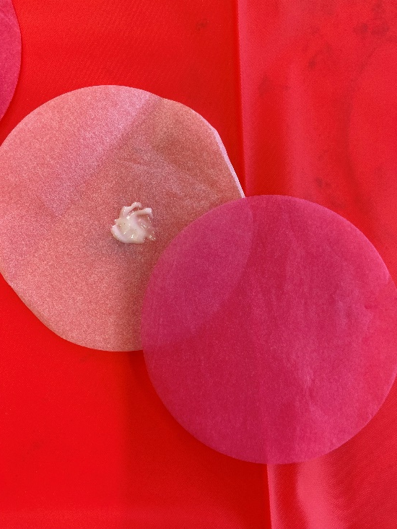
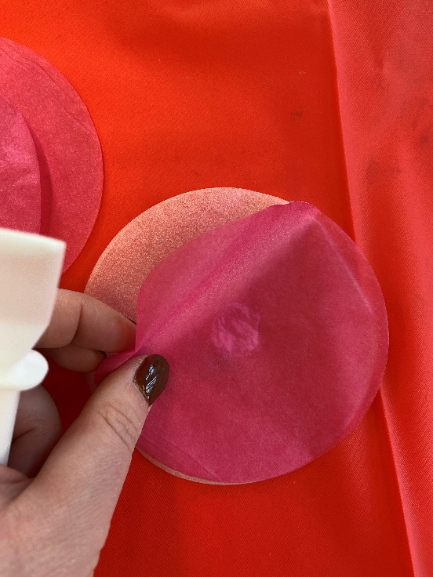
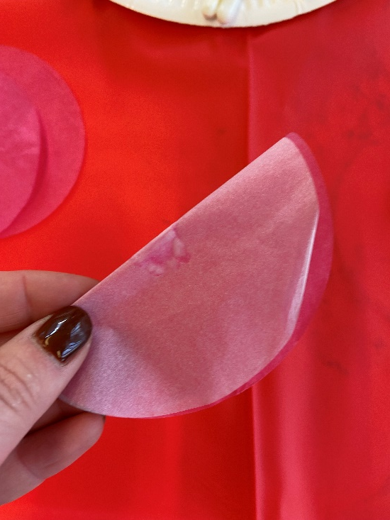
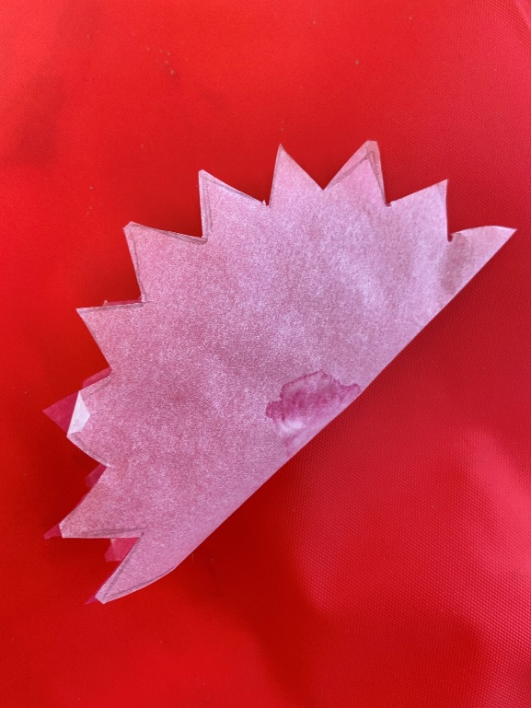
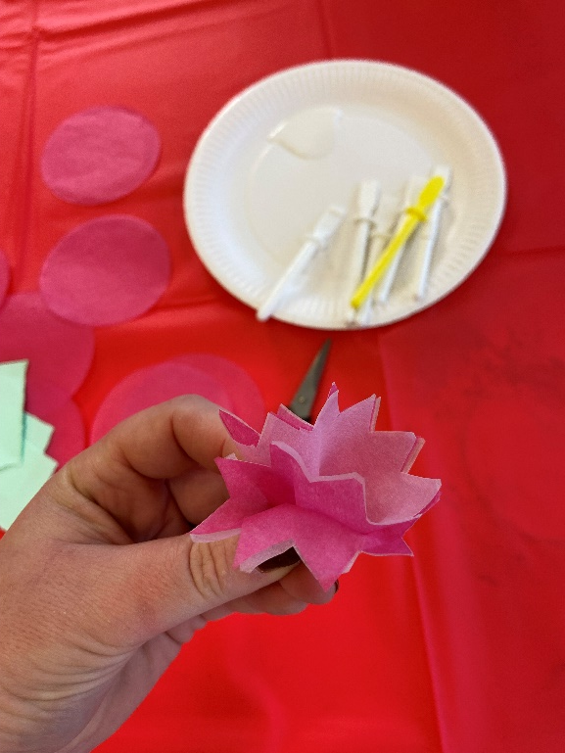
Draw zig zags
Glue together
Fold
Cut out
COLLAGE
Skill: Create a relief using collage materials.
Twist to shape

