Slide 1
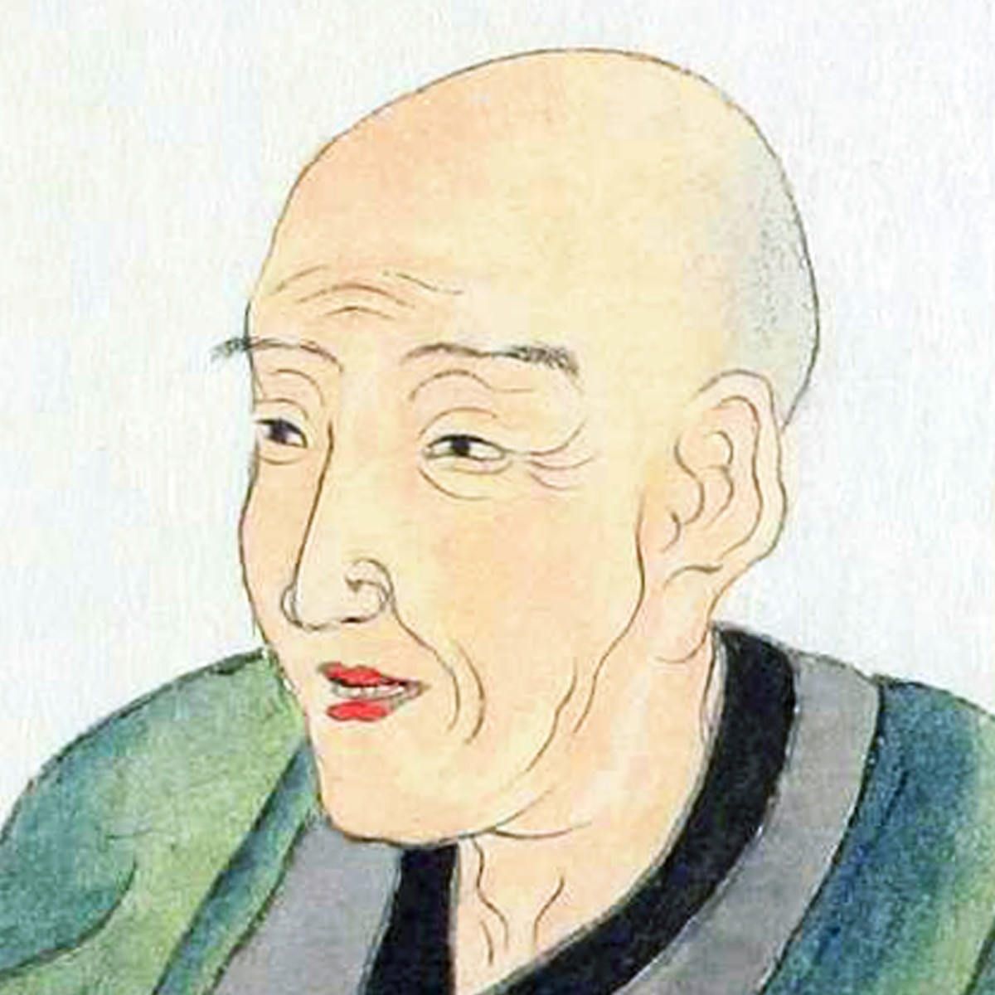
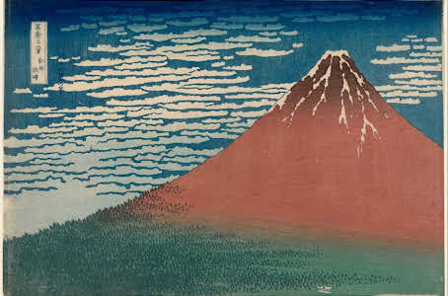
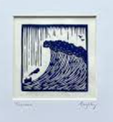
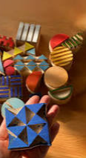
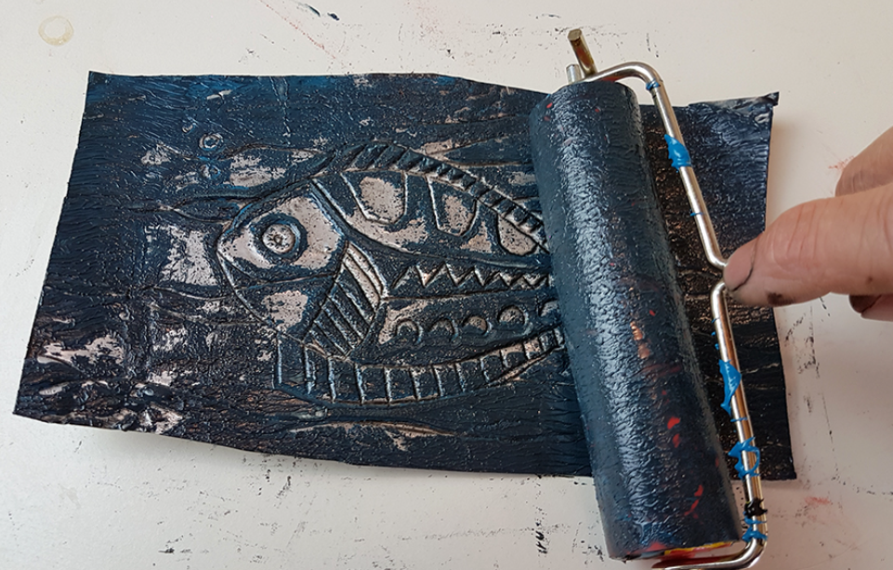
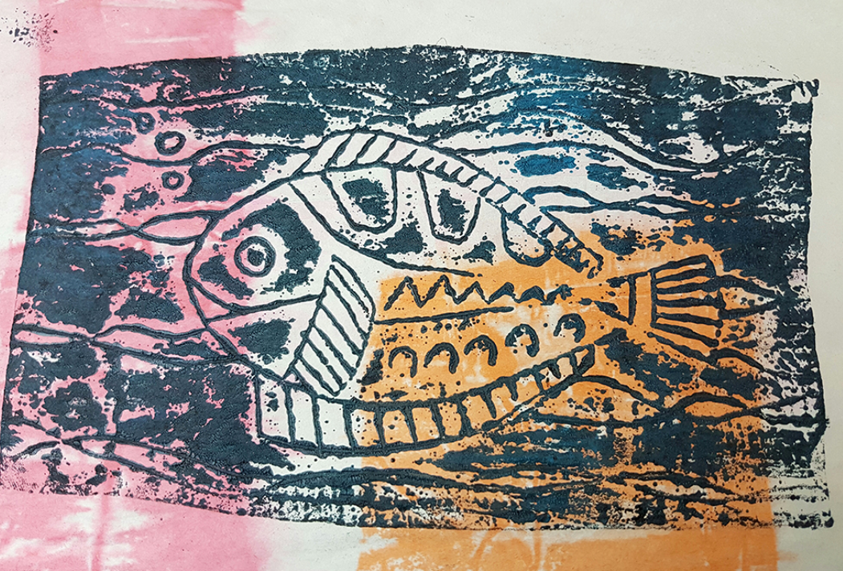
Katsushika Hokusai- Edo Period Etching Printmaking unit: LKS2 Knowledge Mat
Art Vocabulary
Etching | Etching is traditionally the process of using strong acid to cut into the unprotected parts of a metal surface to create a design in the metal.
Engraving | A print made from an engraved plate, block, or other surface.
Ink Roller | Ink rollers, also referred to as printing rollers, are rubber rollers that either contain ink within the roller itself or are engraved with the pattern desired to be printed
Printmaking Ink | Printmaking inks are made specifically for block printing, etching, screen printing, lithography, and monotype techniques.
Foam Block Printing | Foam is scraped into/or cut into pieces to create detail and glued onto card base then inked up.
Sticky knowledge In traditional etching, a metal plate is covered with a waxy ground which is resistant to acid. The engraver draws a design onto the surface of the waxy plate which is then dipped in acid. The acid bites into the surface of plate which is then able to hold ink ready for printing. Great Master artists such as Rembrandt and William Blake used this process for their work. Clearly this process is too hazardous for school children to learn and use in the modern classroom, but the fundamental principles can be adopted by etching into soft aluminium instead of using metal, wax and acid. The Edo period or Tokugawa period is the period between 1603 and 1867 in the history of Japan.
known simply as Hokusai, was a Japanese artist, ukiyo-e painter and printmaker of the Edo period. Hokusai is best known for the woodblock print series Thirty-Six Views of Mount Fuji which includes the internationally iconic print The Great Wave off Kanagawa.
Score
Clay portrait
Use a ballpoint pen or blunt pencil to draw design.
Final print
Lay paper onto of inked late. Rub on clean side of paper and carefully peel off.
Roll up collograph block.

