Slide 1
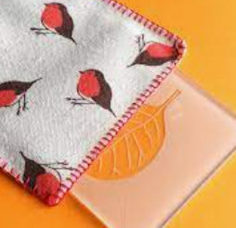
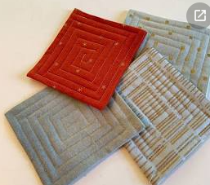
Our Learning Journey: Monoprinting
Our enquiry question: | Conceptual Knowledge | Designers knowledge & Vocabulary | Reflection
Can I find out about Katsushika Hokusia print artist from the Edo period? | Can I take the time to reflect upon what they like and dislike about their work in order to improve it? Can I regularly reflect upon their own work, and use comparisons with the work of others? (pupils and artists) Can I identify how to improve evaluate work using 0-5 scale on your Learning Journey? | Katsushika Hokusai born in October 1760, was a Japanese painter and printmaker. He is most famous for his series of prints called “Thirty-Six Views of Mount Fuji”. His most famous piece among these is The Great Wave Off Kanagawa. Hokusai's seemingly timeless images are almost 200 years old
Can I draw linear works depicting the style of Hokusia and Japanese Manga? | Can I use sketchbooks to draw linear works depicting the style of Hokusia to improve understanding of how the artist worked, inform ideas and plan for an outcome. | Manga is a style of comic books and graphic novels that was developed and popularized in Japan. Like all comics, manga depend on pictures with accompanying text bubbles. In fact, the word manga means “whimsical pictures” in Japanese. In the early 20th century authors created manga mainly for children.
Can I use different brushes/pencils/pen/paint for different purposes? | Can I select and use relevant resources to develop their ideas (based on Hokusai) | 0-10 brushes for fine detail and background painting. 2B-6B shading pencils to add tone. Erasers to add highlights. Paint/Ink to create monprints-blending colours.
Can I understand the key skills of Monoprinting? Can I use a Hokusia OR Manga style to create a monoprint? | Can I explain how to use some of the tools and techniques chosen to work with? Can I use tools, material and techniques effectively and safely? | The monoprint is a form of printmaking where the image can only be made once, unlike most printmaking which allows for multiple originals
Can I use running stitch to add quilted effect and use blanket stitch to edge coaster neatly?
End of Unit Assessment: | Children put on an exhibition for the local library and leave feedback forms. Revisit and read what members of the public think of our Art display.

