Slide 1
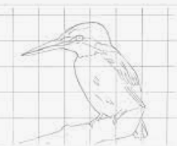
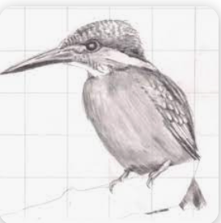
Our Learning Journey: Street Art Figures
Our enquiry question: | Conceptual Knowledge | Designers knowledge & Vocabulary | Reflection
Can I find out about local street artists ‘Phlegm’ & ‘Sarah Yates’? | I can recall facts local street artists ‘Phlegm’ & ‘Faunagraphic’. I can analyse works Phlegm & Sarah Yates. I can work like a street artist. | Street art is a form of artwork that is displayed in public on surrounding buildings, on streets, trains and other publicly viewed surfaces. Phlegm is an internationally renowned street artist and has contributed many murals to Sheffield’s walls over the years. His surreal illustrations are normally monochrome, although Sheffield has had some rare multi-coloured murals painted by the artist. Local freelance artist Sarah Yates is better known as Faunagraphic and is responsible for numerous wall murals across Sheffield. Her works tend to be heavily influenced by nature, particularly birds. The colour green is a common feature of her art.
Can I draw animal/creature figures on a large scale? | I can use a grid to sketch animals accurately. I can use close observations to depict detail.
Can I experiment with colour mixing to mimic colour palette of Phlegm/Faunagraphic? | I can mix secondary, tertiary, tints and tones to mimic a colour palette that resembles Faunagraphic. I can mix endless grey tones and tints to mimic colour palette of Phlegm. | Secondary colours- 2 primary colours mixed together. Tertiary Colours- 1 Primary and 1 secondary colour. Tint- A colour with white added to lighten. Tone- A colour with black added to darken.
Can I use movement and tools to re create a ‘graffiti’ style? | I can use different brushes sizes effectively. I can use sweeping motions in different directions to create movement. | ‘0’ brush (smallest) ‘30’ brush (largest)
End of Unit Assessment: | Children put on an ‘outdoor’ exhibition for parents to see. Children talk through their journey.

