Slide 1
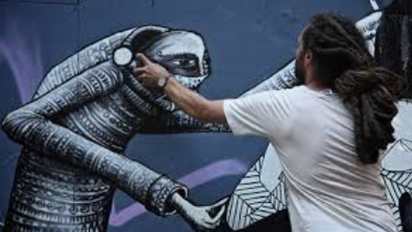
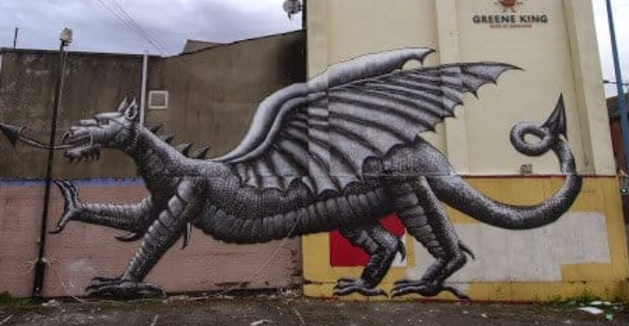
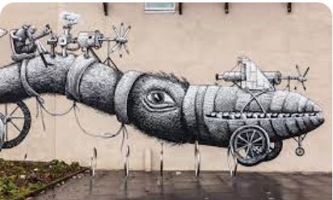
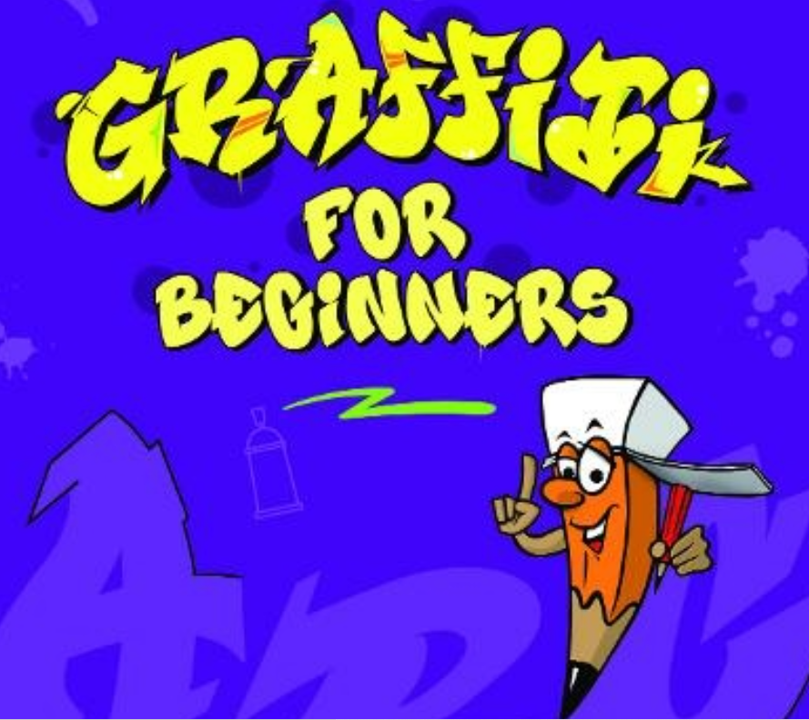
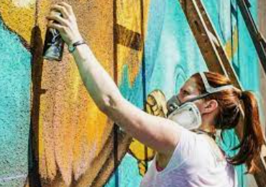
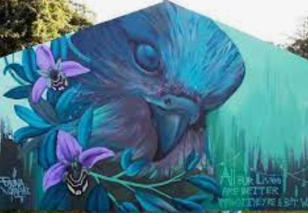
Street Art- Faunagraphic & Phlegm Painting unit: KS2 Knowledge Mat
Art Vocabulary
Street Art | Defined as “public-space artwork that's created for consumption outside of the typical art gallery setting,
Graffiti | Graffiti is word-based, whereas Street Art is image-based.
Spray Paint | Perfect for artists, street art, and DIY. Spray paint has a perfect finish, exceptional coverage, and rapid drying and is contained in an aerosol can.
Mural | A mural is any piece of graphic artwork that is painted or applied directly to a wall, ceiling or other permanent substrate. Mural techniques include fresco, mosaic, graffiti .
Brushstrokes | The configuration given to paint by contact with the bristles of a brush. also : the paint left on a surface by a single application of a brush or palette knife.
Sticky knowledge Faunagraphic, Also known as Sarah Yates was born in Blackburn, Lancashire, England in 1987. Then spent most of the childhood in the Yorkshire town of Todmorden. Her spraypainting journey began in 2008 when she first picked up a can at the age of 19 during her Graphic Design Degree with idea’s to merge graphics with nature related realism. She then continued over 15 years growing her creative portfolio being based in Sheffield but painting murals and canvas for projects, events & galleries within the UK and internationally. Faunagraphic’s work has been featured on BBC Earth, BBC Country-file & Spring-watch to name a few and is included in various art publications.
Graffiti for beginners
Claude Monet
Phlegm is a world-known cartoonist and illustrator from Wales. He is also well known for his self-published comics and highly creative street art. Phlegm’s work is distinctively detailed composed of odd figures and a narrative structure. His work inspires greatness and is even often inspired by graffiti where Phlegm transforms run down urban spaces and factories.
Try these tasks at home:
How to be a street artist
Street Art-Behind the News
‘Waterlilies’ 1916-1919

