Slide 1
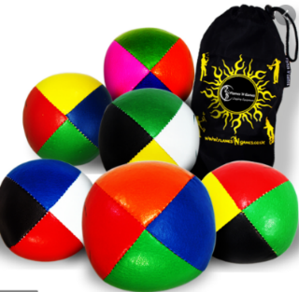
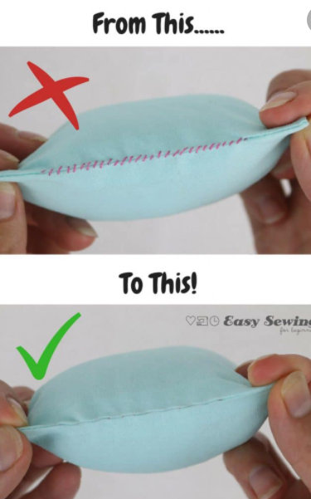
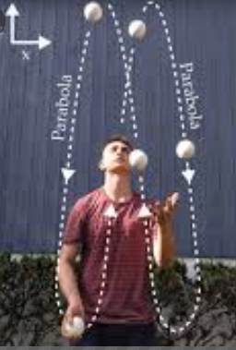
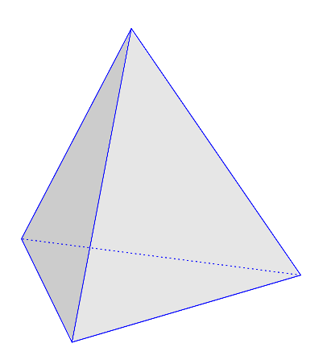
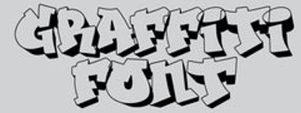
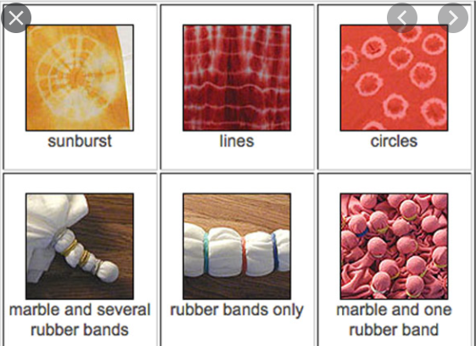
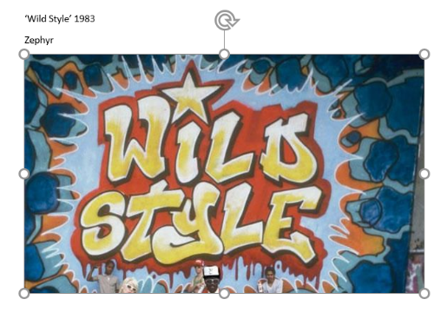
DT Juggling Bags: UKS2 Knowledge Mat
Design & Technology Vocabulary
Waterproof | A fabric which does not allow water in.
Water-repellent | Fabric with a coating to prevent water from soaking in.
Leather | Durable material from animal raw hide.
Cotton | A fluffy fibre grown on the cotton plant.
Synthetic fabric | Fibres made from chemicals.
Invisible stitch | Joining two pieces of fabric with threads that that are invisible.
Running stitch | A basic stitch worked by passing the needle in and out of the fabric a regular distance.
Juggling Bag | A popular prop used by jugglers in sets of 3 or more.
Tetrahedron | A solid shape have 4 plain triangular faces.
Cube | A 3D shape with six square faces.
Sphere | A round solid shape with every point on it’s surface equidistant from its centre.
Seam | A line where 2 pieces of fabric are sewn together.
Durable | Strong, able to withstand wear.
Tie-Dye | Produce patterns on cloth by tying parts to shield it from the fabric dye.
Sticky knowledge about Juggling Bags
Juggling beanbags are typically constructed with an outer shell made from several pieces of vinyl or microfiber (imitation leather), and filled with millet, birdseed, plastic pellets, sand, crushed rock, ground rubber, or other material designed to give the beanbag bulk.
Juggling balls, or simply balls, are a popular prop used by jugglers, either on their own—usually in sets of three or more—or in combination with other props such as clubs or rings. A juggling ball refers to any juggling object that is roughly spherical in nature.
The oldest known depiction of juggling was found in the Beni-Hassan tombs from the middle-kingdom of the ancient Egyptian civilization. These women jugglers were found amongst acrobats and dancers in one of the crypt's wall paintings.
Between the fourth and fifth centuries B.C. many jugglers began appearing in Greek art, usually as pottery decoration. Juggling was considered a form of recreation by the Greeks and many of its practitioners were women.
Invisible Stitch
Art created in a public place using spray paint.
Tie-dye techniques

